Slide 1
OLG Risk Management & Internal Audit Guidelines Review
Penny Corkill, Director Risk & Assurance
Susan Leahy, Senior Manager Risk & Assurance
November 2023

Slide 2
Background
The Local Government (General) Regulation 2022 has now been amended to give statutory force to key elements of the Office of Local Government’s (OLG) Guidelines for Risk Management and Internal Audit for Local Government in NSW (the Guidelines).
Regulations give statutory force to elements of the Guidelines – they are the “what” whilst the Guidelines are prescriptive (the “how”)

Slide 3
The Framework
Councils are required to have the following by 1 July 2024:
A fully operational and independent ARIC by 1 July 2024
a risk management framework
an internal audit function

Slide 4
ARIC Requirements
ARIC Terms of Reference – consider model terms of reference approved by OLG
Term limits for members
Mayor may have a standing invitation (but non-voting)
Other Councillors may have a standing invite (at discretion of ARIC Chair)
Non-voting Councillor can nominate an alternate
Staff appointment to other Council ARICs
Annual reporting from 2024/2025

Slide 5
Risk Management Requirements
Develop and implement a risk management framework (AS ISO 31000-2018)
Strategic leadership – risk appetite statement to be approved by Council
ARIC monitoring and review, with reports to Council on risk management operation and efficacy
Regular evaluation – internal audit to review and provide assurance

Slide 6
Internal Audit Requirements
Council to adopt an Internal Audit Charter (model IA Charter approved by OLG)
Appointment of a staff member to coordinate IA and report to ARIC
Independence
Oversight by ARIC

Slide 7
OLG Exemption Provisions
Resourcing and budget constraints
Sharing resources between Councils
Current or proposed alternative arrangements
Notifying the OLG regarding non-compliance
Annual reporting requirements

Slide 8
Complying with the Guidelines
Get involvement of ARIC by including guidelines as an agenda item moving forward
Involve risk managers and other assurance providers
01
03
GM and Executive buy in
Complete a gap analysis
02
04

Slide 9
Gap Review – ERM Example
FRAMEWORK REQUIREMENT | PAGE NUMBER | COMPLIANCE | ACTION REQUIRED TO COMPLY
Council must implement a risk management framework consistent with the current Australian risk management standard: AS ISO 31000:2018 Risk Management Guidelines. | 42 | Draft risk framework complies | As part of finalisation of ERM framework review the following requirements need to be considered to ensure completeness and compliance
AS ISO 31000:2018 eight principles adopted and implemented: Risk Management is: Integrated Structured and Comprehensive Customised Inclusive Dynamic Best available information Human and Cultural factors Continual Improvement | 42 | Draft risk framework complies
To achieve these principles Council’s Risk Management Framework demonstrates the following six principles: Leadership and Commitment Integration Design Implementation Evaluation Improvement | 43 | Draft risk framework complies
Council adopts ISO 31000:2018 process for risk identification and management including: Scoping Council’s risk management activities Establishing the internal and external context Establishing performance indicators to measure the effectiveness of risk management Establishing risk appetite Conducting risk assessments Deciding risk treatments Developing risk plans Writing risk reports | 44 | Draft risk framework complies
Notes:
Maturity of framework
Risk register, risk appetite, policy , understanding across council

Slide 10
thoughts

Slide 11
Lessons learned…
IA documentation (e.g. Charter, manual / procedures)
Transitioning ARC to ARIC membership
Maintaining work papers
Resourcing / independence
IA planning (strategic and annual)
Annual reporting requirements / showcasing audit achievements

Slide 12
Considerations for the future
Professional expectations
Consistency over the NSW LG sector
Independence
Share resources

Slide 13
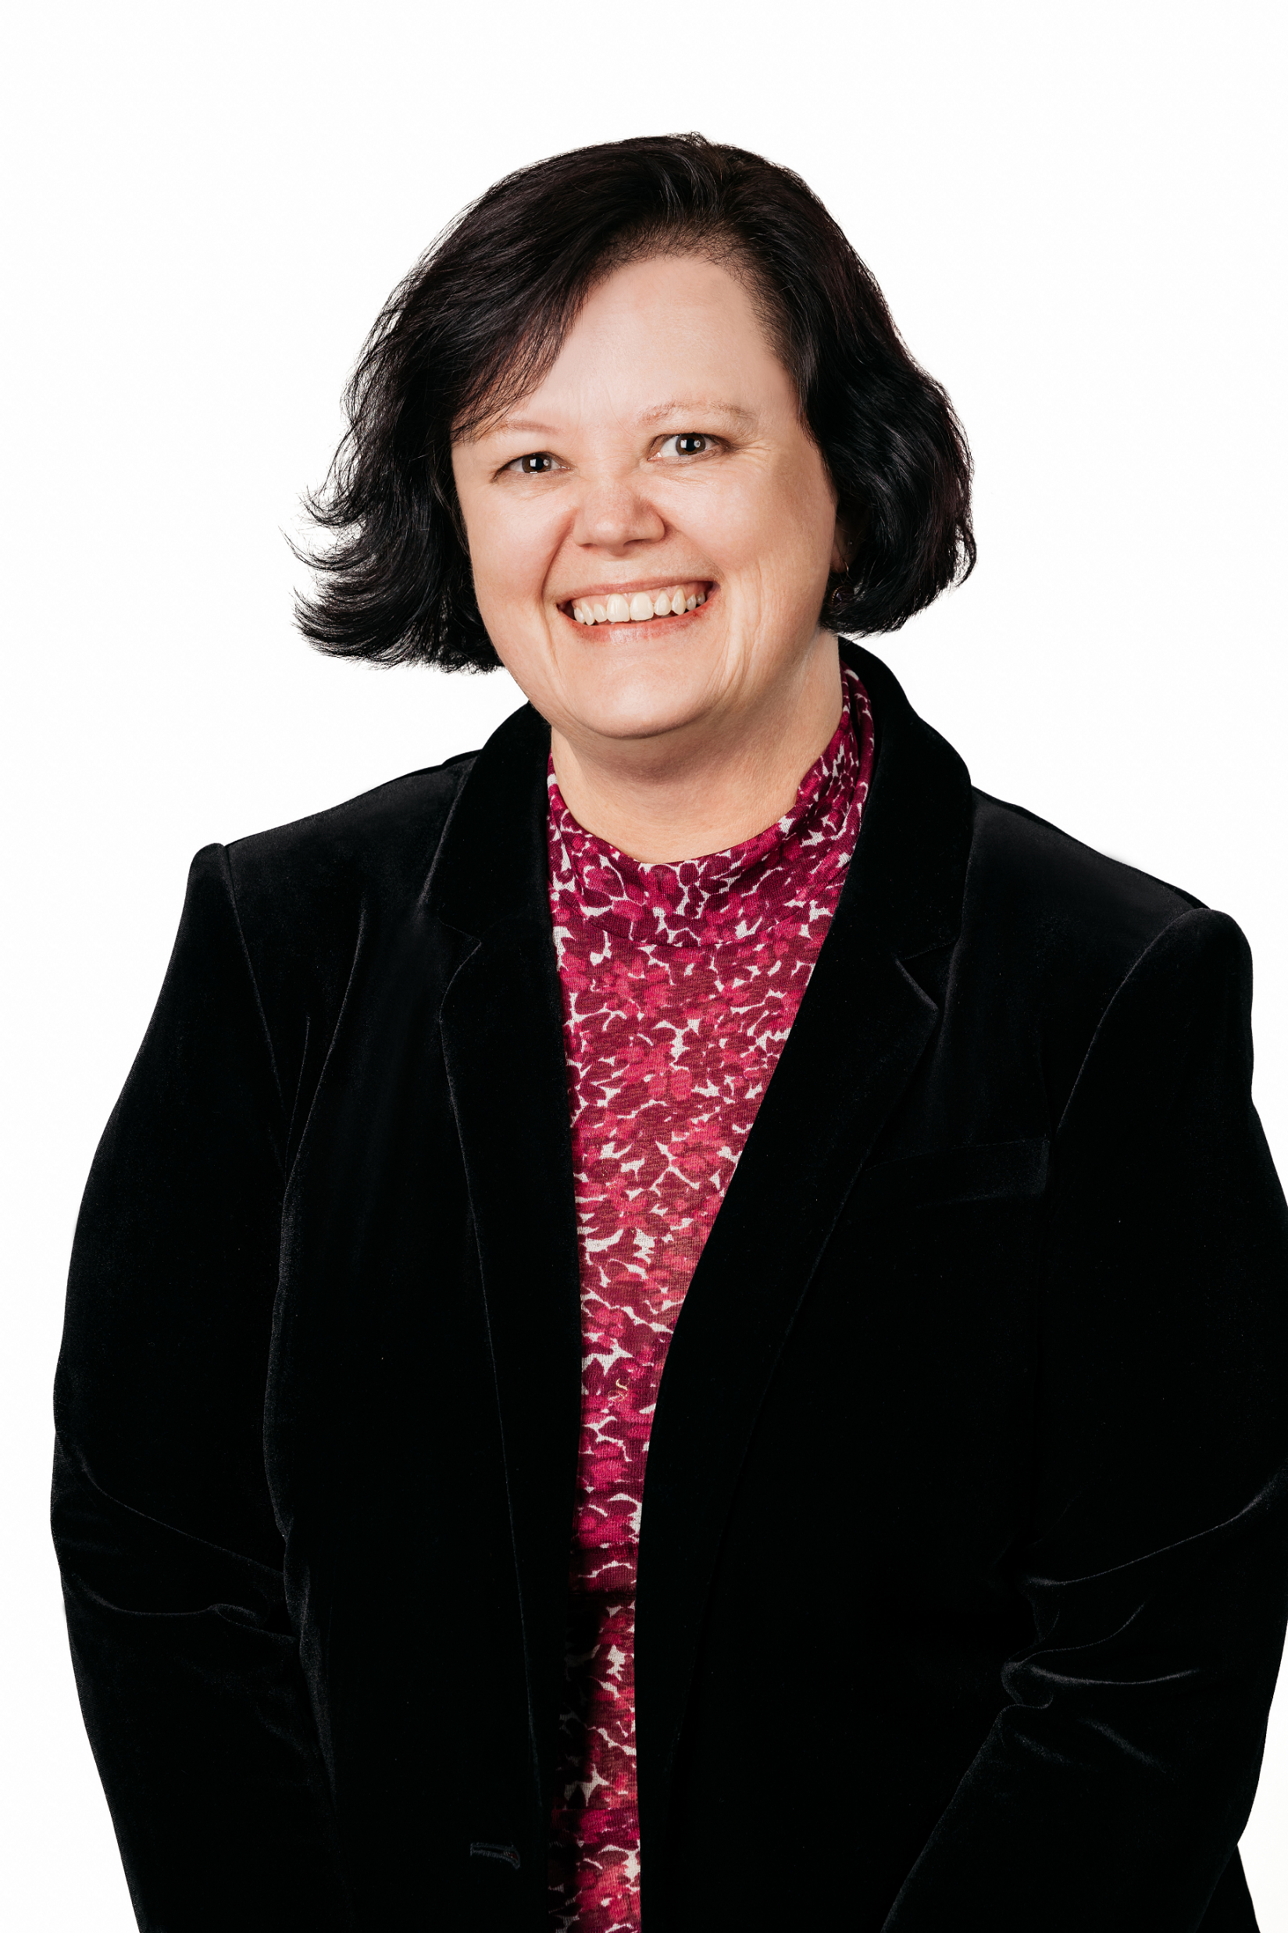
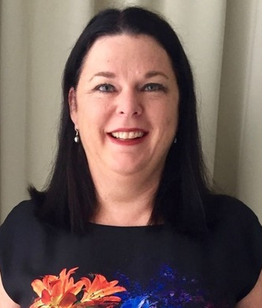
For more information
PENNY CORKILL
Director Risk & Assurance
0409 251 011
SUSAN LEAHY
Senior Manager Risk & Assurance
1300 237 810
centium.com.au
linkedin.com/company/centium/

